Slide 1
RD51 Annual Report Development of Micro Pattern Gas Detector Technologies
Leszek Ropelewski, EP-DT-DD, CERN, Switzerland
On behalf of the RD51 Collaboration

Slide 2
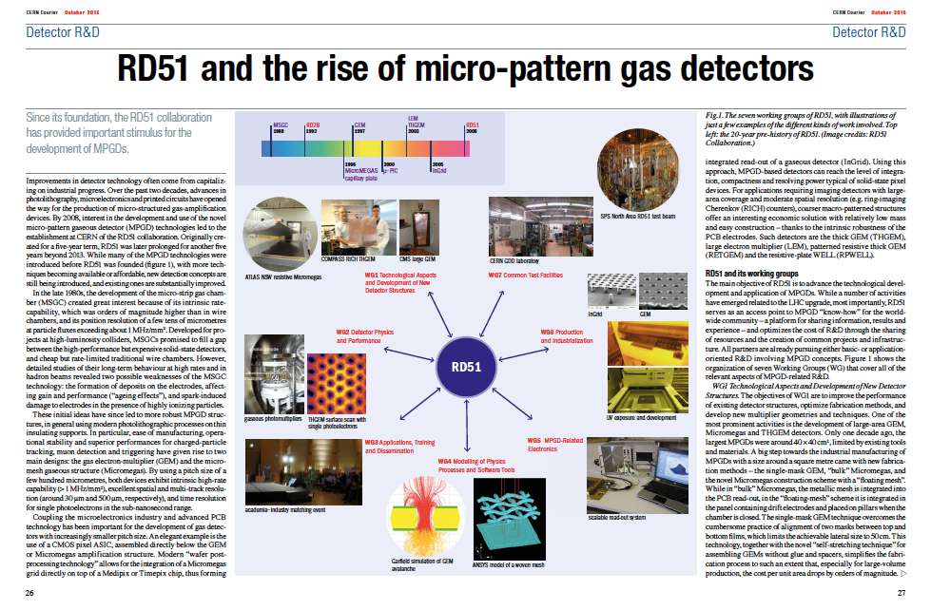
http://cerncourier.com/cws/article/cern/62507

Slide 3
RD51 Achievements and Highlights
Consolidation of the Collaboration and MPGD community integration ( 86 Institutes, ~500 members);
Major progress in the MPGD technologies development in particular large area GEM (single mask), MicroMegas (resistive), THGEM; some picked up by experiments (including LHC upgrades);
ALICE, TPC read-out, 130 m² to be instrumented
ATLAS, small wheels, 1200 m² to be instrumented
CMS, forward detectors, 1000 m² of GEM foils
COMPASS RICH, 4.5 m² to be instrumented, single photon detection
Secured future of the MPGD technologies development through the EP DT MPT workshop upgrade and FP7 AIDA & AIDA2020 contribution;
Contacts with industry for large volume production, MPGD industrialization and first industrial runs;
Major improvement of the MPGD simulation software framework for small structures allowing first applications;
Development of common, scalable readout electronics (SRS) (many developers and > 50 user groups); Production (PRISMA company and availability through CERN store); Industrialization (re-design of SRS in ATCA in EISYS);
Infrastructure for common RD51 test beam and lab facilities (>20 user groups)

Slide 4
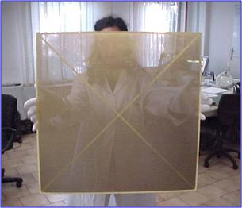
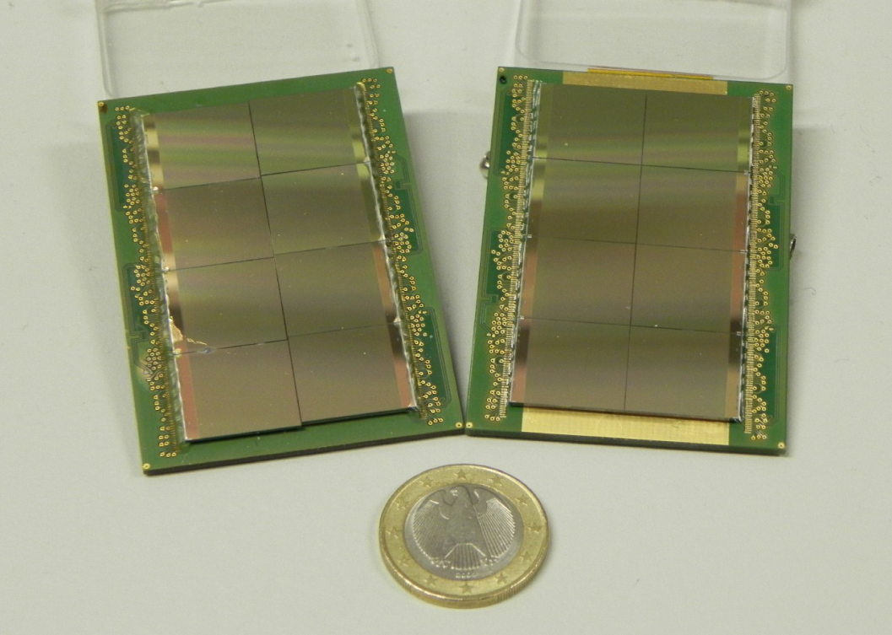
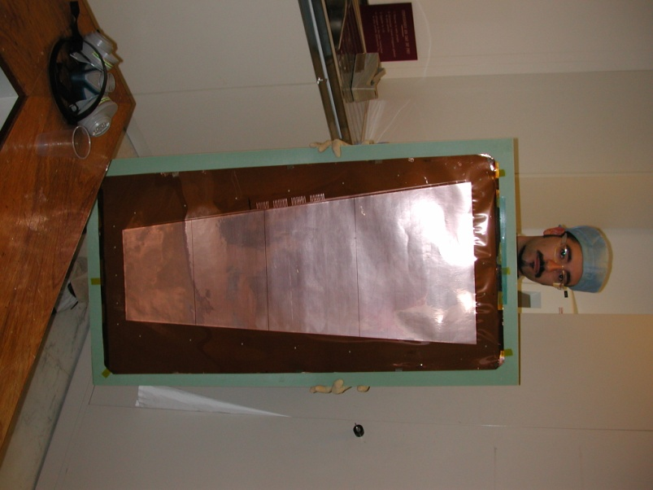
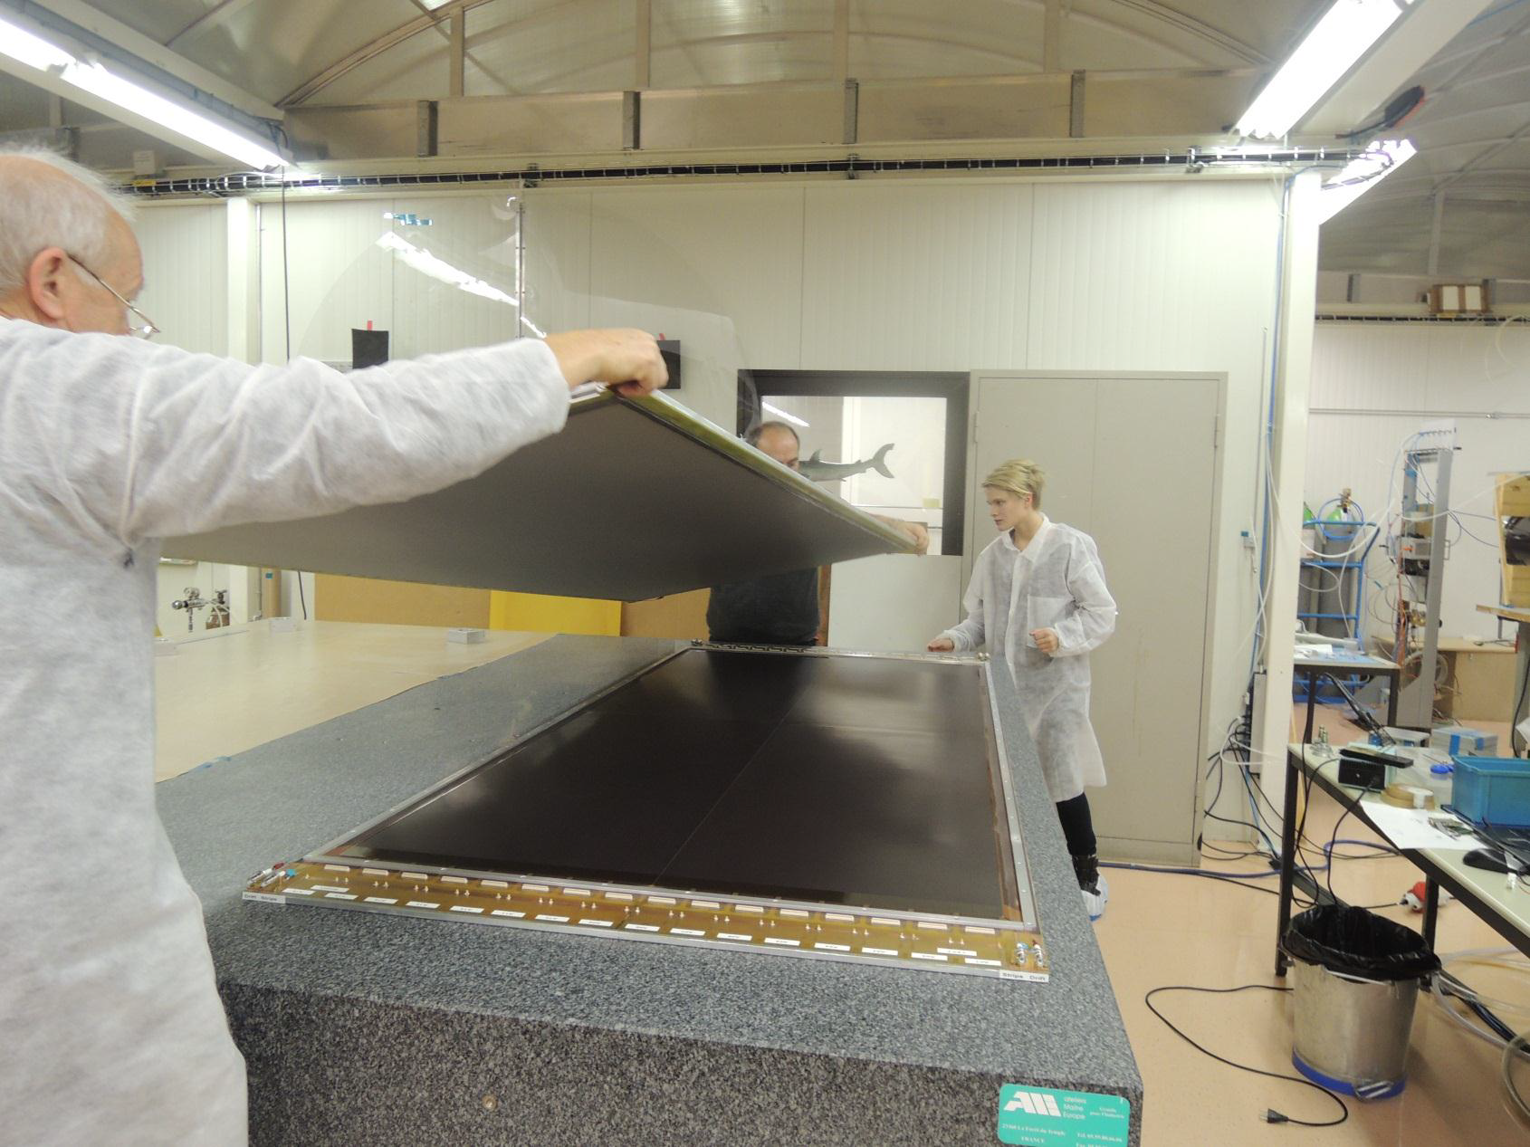
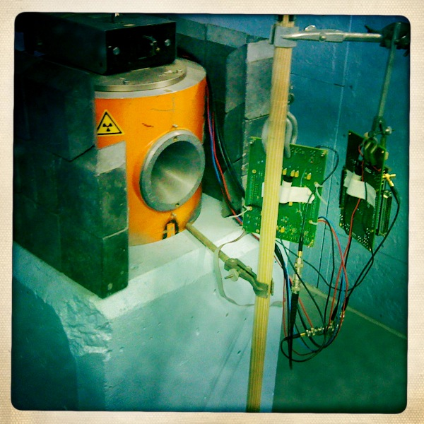
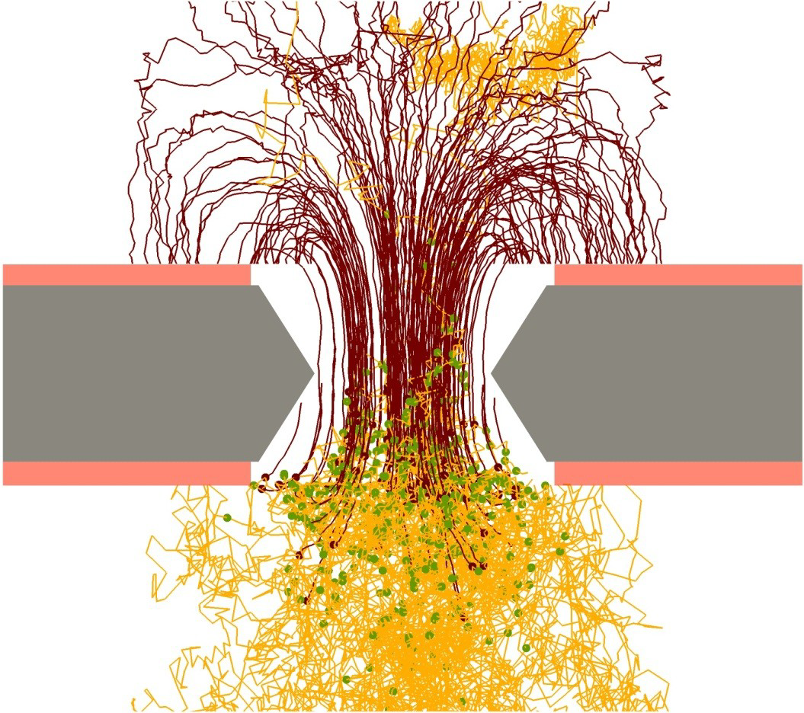
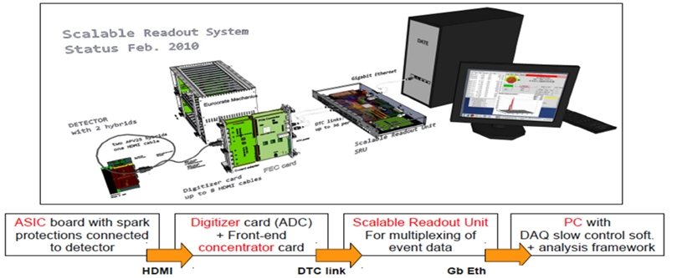
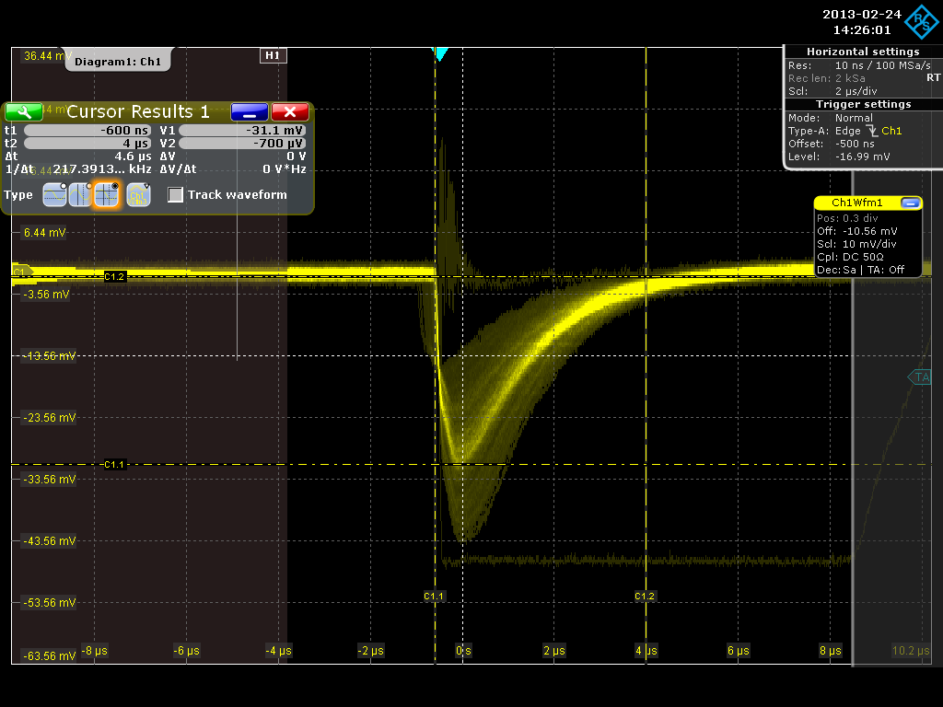
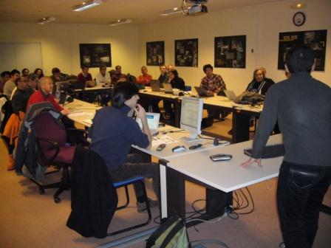
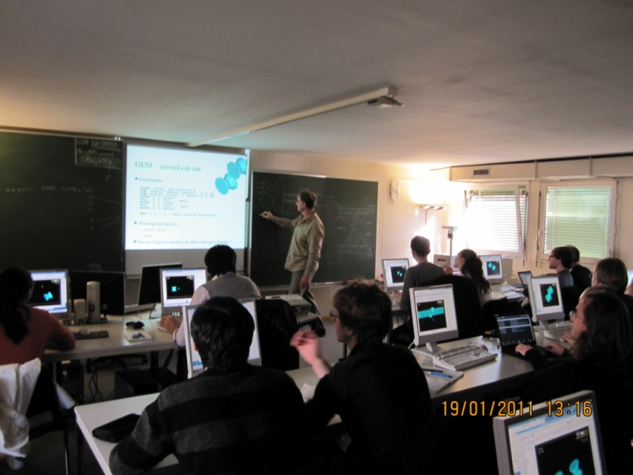
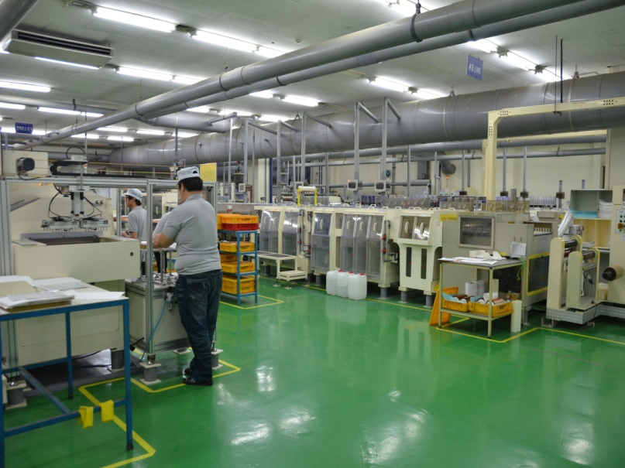
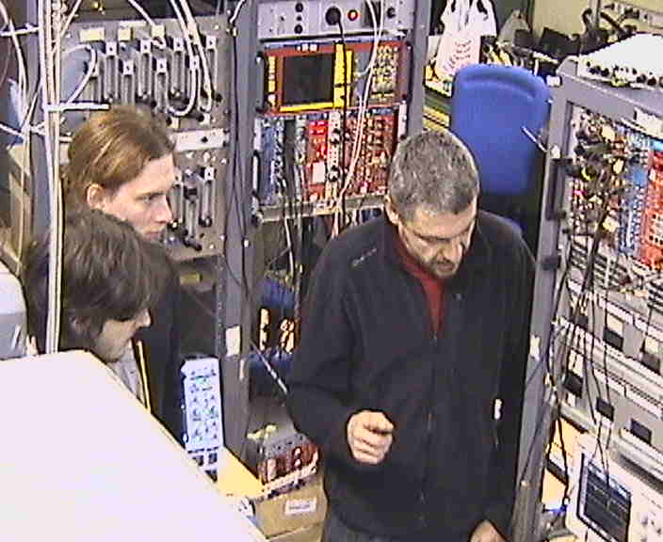
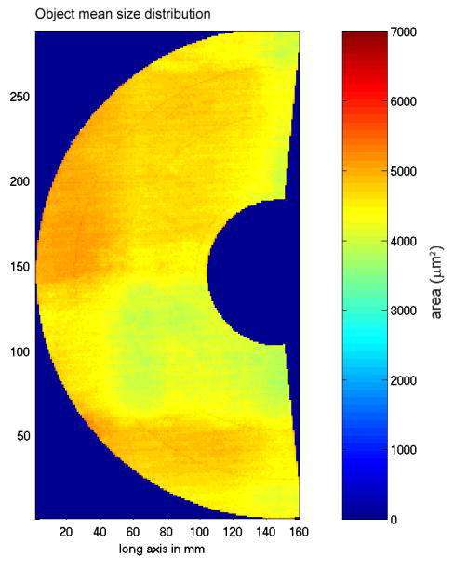
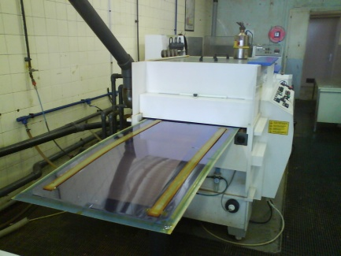
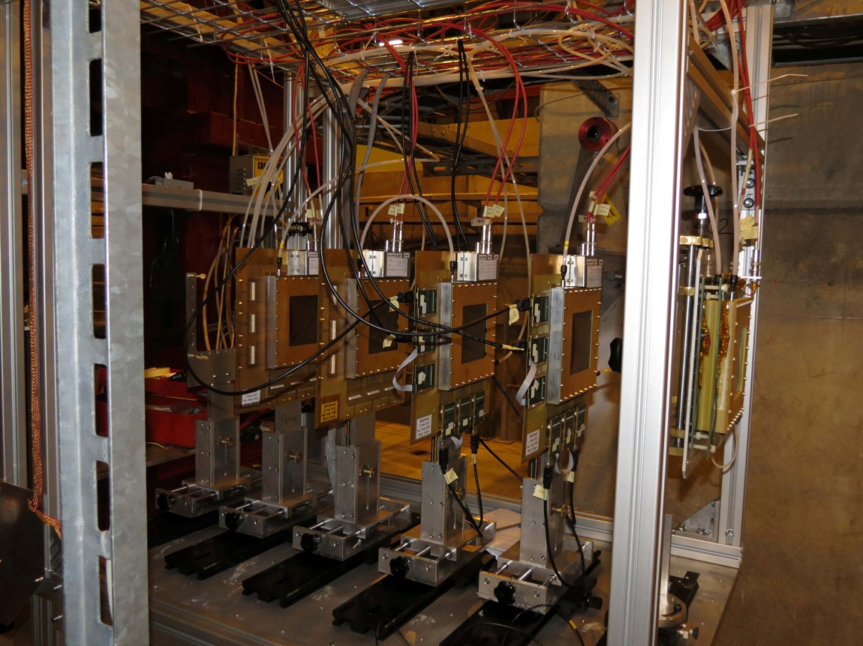
RD51 Collaboration
Technological Aspects
New Detector Structures
Detector Physics and
Performance
RD51 Common Projects
WG2:
WG1:
WG5:
RD51
MPGD Electronics
Modeling of Physics Processes
Software Tools
WG4:
WG7:
WG6:
Applications, Training
and Dissemination
WG3:
Common Test Facilities
Production and Industrialization

Slide 5
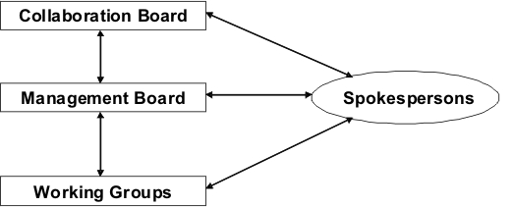
RD51 New Scientific Organization
Members of the RD51 Collaboration Management Board (MB):
two Co-Spokespersons: Silvia Dalla Torre, Leszek Ropelewski
CB Chairperson and its deputy: João Veloso, Atsuhiko Ochi
Scientific Secretary: Maxim Titov
Technical Coordinator: Eraldo Oliveri
MB members: Amos Breskin, Paul Colas, Klaus Dehmelt, Ioannis Giomataris, Hans Taureg (Finances), Andy White
+ 3 to be elected
Working Groups Conveners:
WG1 - New Structures and Technologies (Paul Colas, Filippo Resnati)
WG2 - Detector Physics and Performance (Diego Gonzalez Diaz, Max Chefdeville)
WG3 - Training and Dissemination (Fabrizio Murtas, João Veloso)
WG4 - Modeling of Physics Processes and Software Tools (Ozkan Sahin, Rob Veenhof)
WG5 - Electronics for MPGDs (Jochen Kaminski, Hans Muller)
WG6 - Production and Industrialization (Fabien Jeanneau, Hans Danielsson, Rui de Oliveira)
WG7 - Common Test Facilities (Eraldo Oliveri, Yorgos Tsipolitis)

Slide 6
RD51 present and future activities
Continuation of the R&D support for the experiments and LHC upgrades WG1
Generic R&D (new structures, ideas, detector physics) – RD51 Common Projects WG2 Development of new structures and consolidation of the existing structures
Applications - organization of series of specialized workshops disseminating MPGD applications beyond fundamental physics – RD51, potential users and industry (e.g. dosimetry, neutron detection, medical physics, …) WG3
MPGD Education and Training : organization of schools for students and newcomers & academic training WG3
Development and Maintenance of Software & Simulation Tools; basic studies & software support for the RD51 community WG4
Development and Maintenance of the SRS Electronics; An extended support for the SRS including new developments and implementations of additional features WG5
MPGD Industrialization and QA Control - GEM, MicroMegas, Thick GEM; WG6
Maintenance of the RD51 Lab and Test-Beam Infrastructure WG7

Slide 7
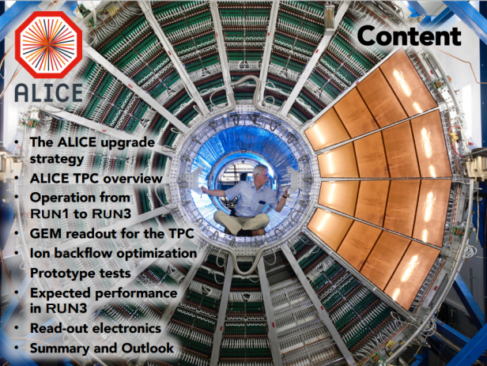
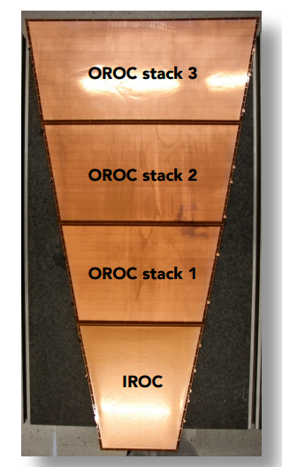
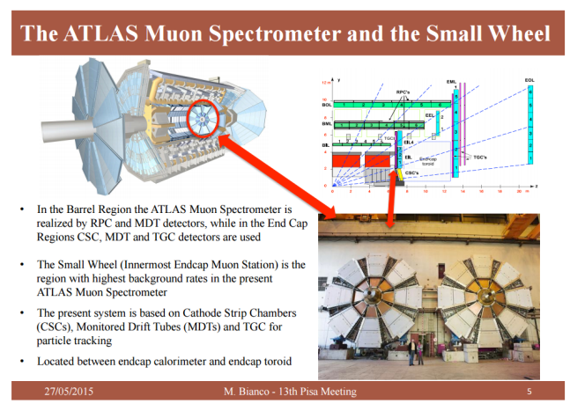
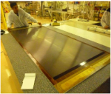
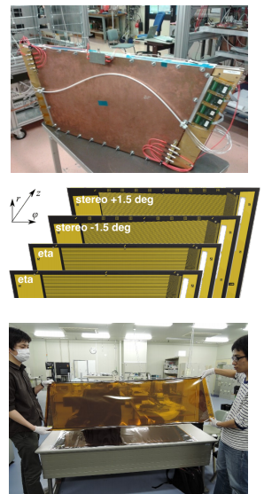
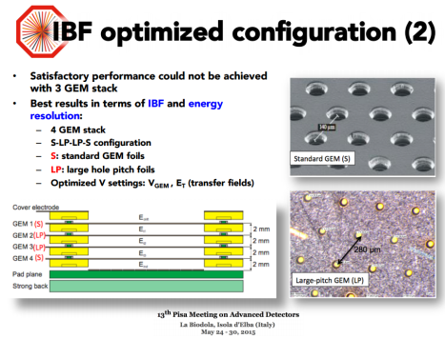
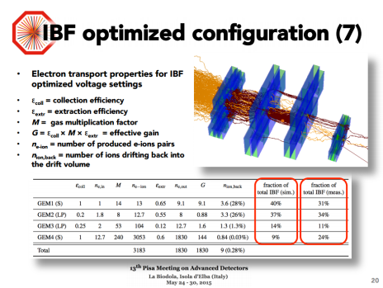
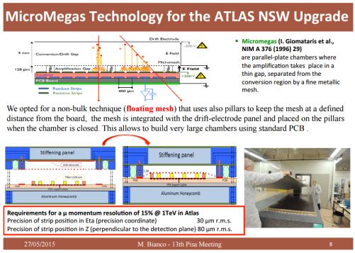
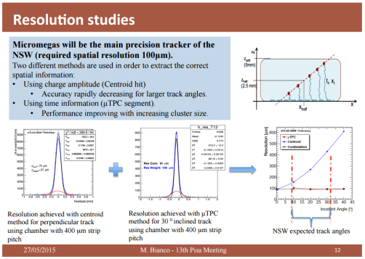
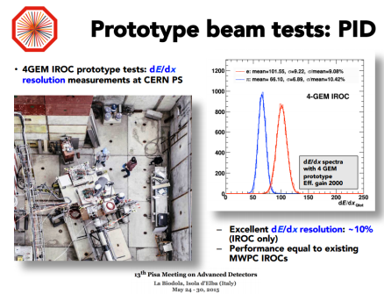
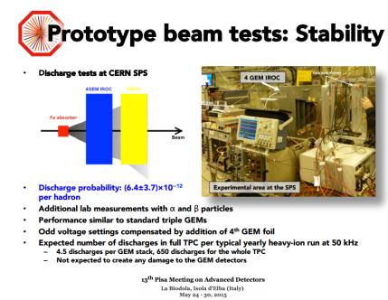
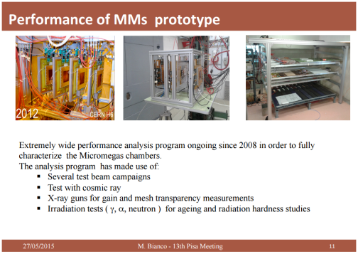
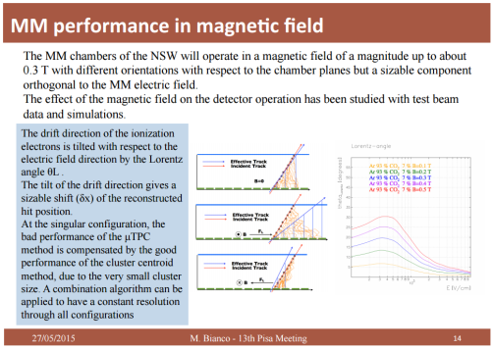
Examples of CERN/LHC Upgrades
ALICE (GEM)
ATLAS NSW (mm)
Micromegas Detectors for the Muon Spectrometer Upgrade of the ATLAS Experiment; M. Bianco, Elba 2015
A continuous read-out TPC for the ALICE upgrade, C. Lippmann, Elba 2015
LHC Upgrades: Original R&D efforts emerged from RD51 activities.
Today: production phase under the project effort , access to RD51 facilities (laboratory, test beam, workshops) and tools (simulation, electronics,…) to facilitate this particular phase

Slide 8
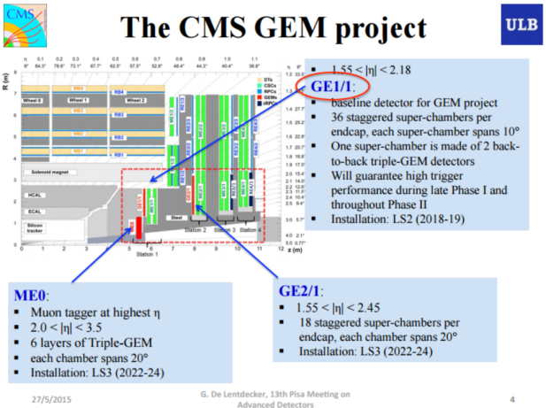
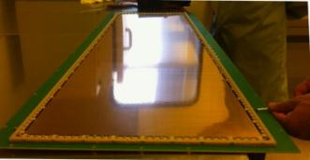
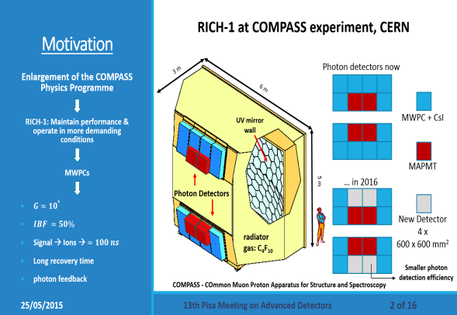
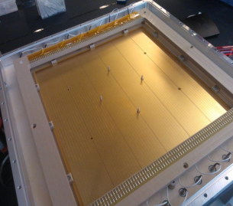
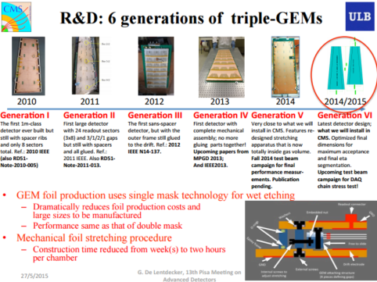
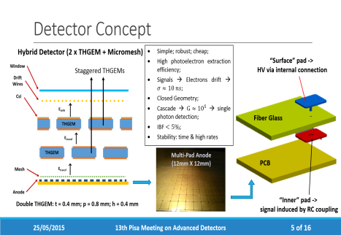
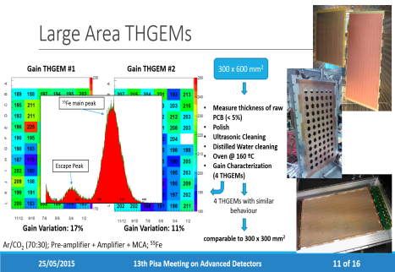
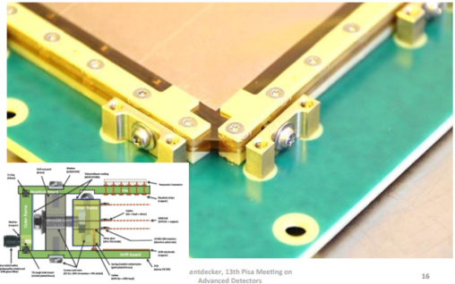
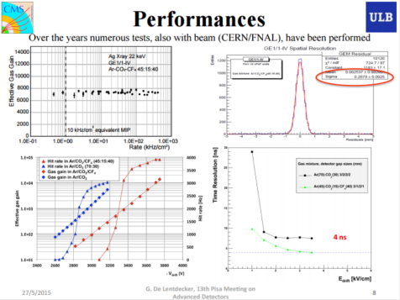
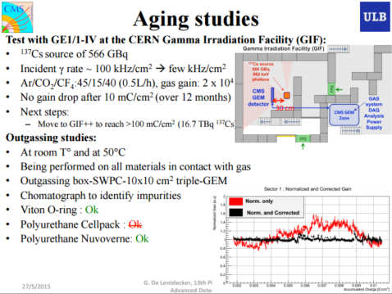
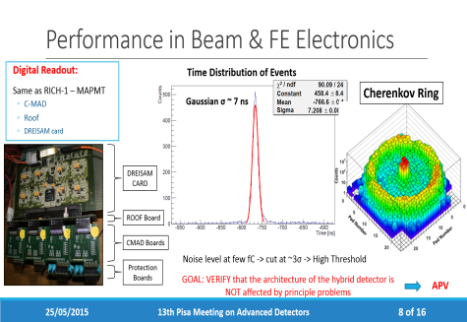
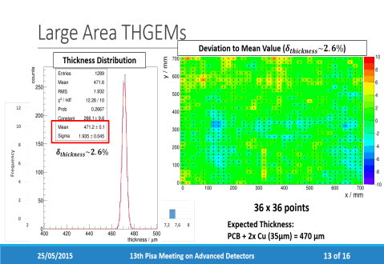
Examples of CERN/LHC Upgrades
CMS (GEM)
COMPASS RICH-1 (THGEM+mm)
Status Report of the Upgrade of the CMS muon system with triple-GEM detectors, G. De Lentdecker, Elba 2015
Status of the Development of Large Area Photon Detectors based on THGEMs and Hybrid MPGD architectures for Cherenkov Imaging Applications , C.A.Santos, Elba 2015
LHC Upgrades: Original R&D efforts emerged from RD51 activities.
Today: production phase under the project effort , access to RD51 facilities (laboratory, test beam, workshops) and tools (simulation, electronics,…) to facilitate this particular phase

Slide 9
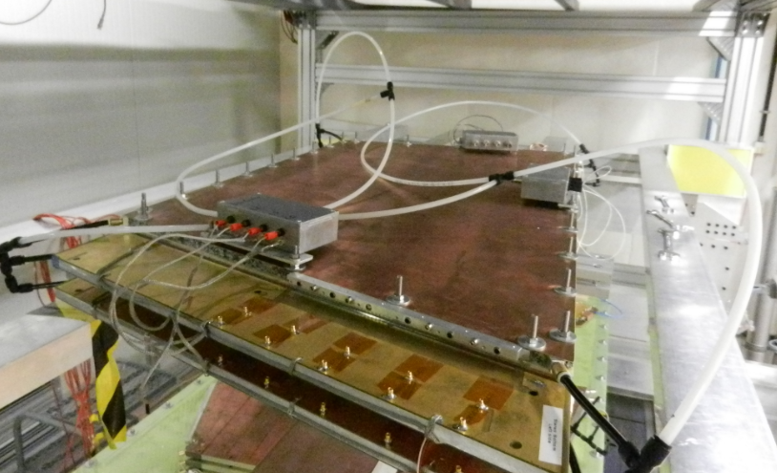
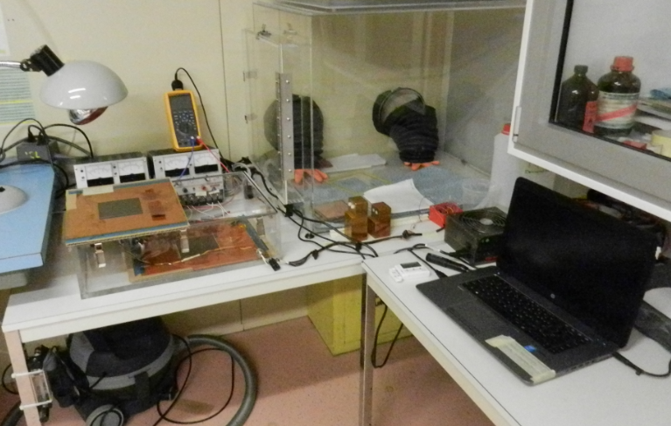
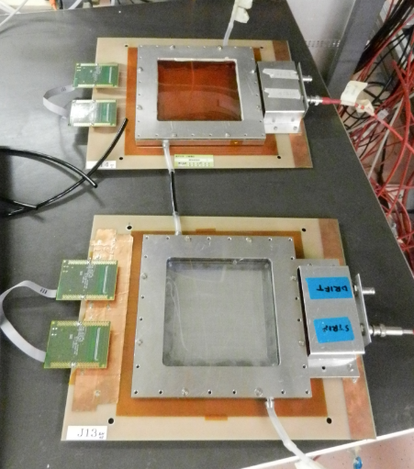
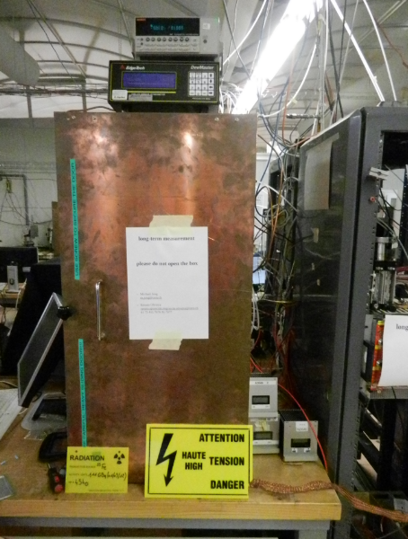
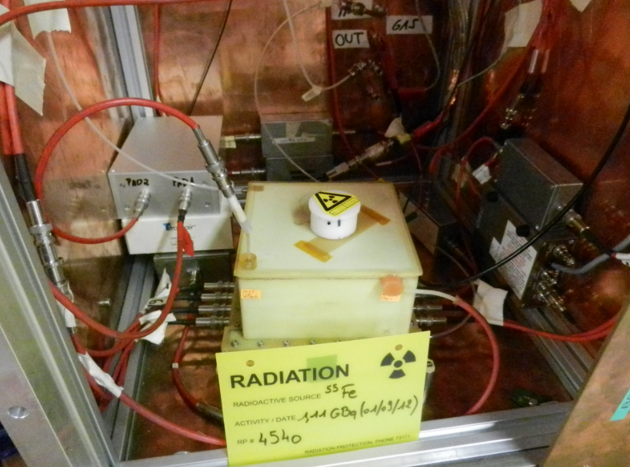
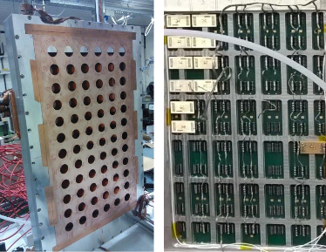
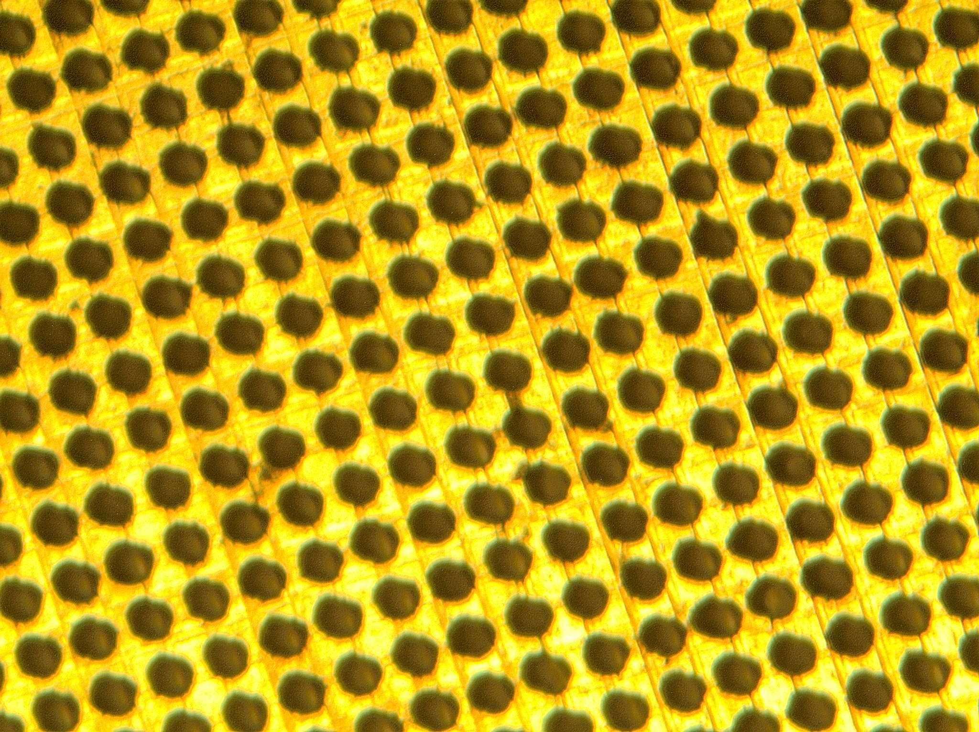
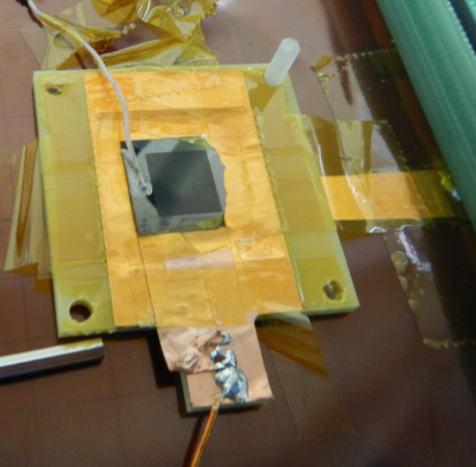











Activities in the GDD/RD51 Laboratory
Experiments
ATLAS NSW: Quadruplet, Environmental Effects, Thinner Gaps mm
ALICE: out gassing, Aging and stability
THGEM – Micromegas - Electronics Compass RICH
Detectors R&D
3 Permanent Installation
(ALICE TPC, ATLAS NSW, ESS)
> 15 groups in visit to perform measurements
Several activities in synergy with external companies
Diamond GEM
CC MSGC
Thick-Groove
Target Exp. GEM TPC
External Companies
Electronics
ATLAS VMM2
ALICE FoCAL
VMM2 and SRS
MPGD Instrumentation Development
CAEN (HV power Supply)
eicSys (ATCA SRS)
9

Slide 10




Generic Detector R&D

Slide 11


MPGD 2015 and RD51 CM in Trieste MPGD2015 and RD51 CM
New Developments in MPDGs
Production techniques
Material and Ageing Tests
MPGD Detector Physics
Simulation and Software
Electronics
Applications
140 participants
120 abstracts
MPGD contributions in recent and running experiments
Conference Summary
Charpak Young Scientist Award

Slide 12


https://indico.cern.ch/event/365840/
https://arxiv.org/abs/1601.01534

Slide 13








O (100 keV) electrons ~MIPs
Alphas from ²²⁰Rn decay and its daughter ²¹⁶Po
Single X-rays from ⁵⁵Fe and the energy spectrum extracted from the images
Freeze-frame of an X-ray movie of a flying drone
Radiography of a crushed cup with pens and its 3D tomographic reconstruction
https://indico.cern.ch/event/392833/

Slide 14


Topical Workshop on Resistive Electrodes
December 2015
https://indico.cern.ch/event/457639/

Slide 15

Topical Workshop on Discharges in MPGDs
March 2016
https://indico.cern.ch/event/496113/timetable/#20160311.detailed

Slide 16


Slide 17




Schools, visits, events…
1st October 'extended NNV visit' of Dutch high school students at CERN
6-7 October (M. Hoffmann)
DOE and Fermilab
Students Visit:
24th November (Zagreb) M. Planinic

Slide 18



WG4 - Modeling of Physics Processes
and Software Tools
Software Tools:
Magboltz (transport equations) and Degrad (cluster size distribution)
Speeding up Garfield++
Optimization of charging up processes simulation
Modeling of Physics Processes:
Penning energy transfers in Ne based gas mixtures
Impact of CO2 cluster ions on the constant field detectors
Dependence of the gas gain on the Gem hole diameter
Impact of the mesh geometry on the performance the Micromegas
18

Slide 19
SRS progress
WG5 - Electronics for MPGDs
VMM128 = 1 MHz frontend for SRS
DVM= digital SRS adapter for VMM /GEMRoc frontends
APV = analogue pickup amplifier/shaper box for MPGD’s
AVD = active voltage divider for MPGD’s
Femtometer
19

Slide 20

1 MHz frontend for SRS: VMM hybrid
APV hybrids : max 3 kHz ➔ VMM hybrids: up 1 MHz
Readout
chip
128 channel
MPGD connector
Spark protection
AC coupling
HDMI Micro (SRS readout /power/control)
2 x VMM2 ASICs with ceramic coolers
VMM-128 status:
2015 : VMM-2/BGA prototypes produced & tested in GDD lab in collaboration with ATLAS NSW
2016 : VMM-3 revision ( wire-bonded hybrid, imminent)*
* major delays due to BGA packaging issues of VMM, RD51 decided for wire-bonded hybrid production
20

Slide 21




21

Slide 22


SRS Users Status
ALICE EMCal Calorimeter upgrade, ORNL, SRS readout backend via DTCC links and 24 SRU’s , DATE Online system,
ATLAS upgrade CERN, MAMMA project NSW , µMEGAS , APV frontend SRS Eurocrates-SRU, MMDAQ Online,
ATLAS upgrade Mainz, µMEGAS for MBTS, APV frontend- SRS Eurocrate, MMDAQ Online,
ATLAS Muon upgrade R&D, INFN Rome, APV frontend SRS Eurocrate, MMDAQ Online,
ATLAS Saclay, µMEGAS R&D, APV frontend SRS Minicrate, MMDAQ Online,
NA62 CERN straw tracker upgrade with µMEGAS, APV frontend with SRS Minicrate, MMDAQ Online,
CMS upgrade CMS GEM collaboration CERN, Muon Endcaps, design of VFAT frontend digital readout SRS
TOTEM upgrade GEMs Baris testlab, OPTO-Rx card design, Minicrate,Eurocrate, SRU, DATE Online,
BNL GEM detectors, APV frontend-SRS Minicrate, RCDAQ Online,
Stony Brook GEM detector R&D, APV frontend SRS Minicrate, RCDAQ Online,
Bonn Phys. Inst. R&D for ILC, T24 DESY testbeam, Timepix Array Ingrid Module adapter for SRS , Eurocrate, Online unknown,
Florida Inst Tech GEMs, Muon Tomografy for Homeland security, 15k channel SRS prototype Eurocrate, DATE Online,
Géosciences Azur-CNRS-UNSA, Muon Tomography w.µMEGAS for geology, APV frontend SRS Eurocrate, Date Online,
GDD lab RD51, CERN, R&D for GEM and µMEGAS, APV frontend SRS Euro and Minicrates, DATE, Labview MMDAQ,
HIP, HELSINKI, characterization MPGAD detactors, APV frontend SRS Eurocrate, DATE and Labview,
INFN Napoli, ATLAS. Development of SRS Hardware and Firmware, Labview,
Jefferson Lab, Virginia UVa upgrade GEM readout system, APV frontend SRS Eurocrate, DATE online,
Yale University , GEM development ALICE, APV frontend SRS Eurocrate, DATE Online,
NEXT Coll. small Xenon TPC with PM and Si PMs, SRS readout electronics co-development, SRS Eurocrate and SRU, DATE
UNAM, MEXICO, MX , R&D on THGEM, APV frontend SRS Minicrate, DATE Online,
Radiation Laboratory, Nishina Center, RIKEN , APV frontend SRS Eurocrate, Online unknown,
J-PARC /E16 experiment, GEM based tracking, APV frontend SRS Minicrate, Online Unknown,
Jefferson Lab SHM spectrometer triple GEM, APV frontend SRS Eurocrate, DATE Online,
Harvard Univ. Physics, APV frontend SRS Minicrate, Online unknown,
Tokyo Univ. ATLAS, APV frontend SRS Eurocrate, Online unknown,
WIS and Aveiro Univ. GEM validation, APV Frontend SRS Eurocrate, MMDAQ and Labview,
East Carolina University, Health Physics, APV frontend, SRS Eurocrate, Labview,
Munich LMU / ATLAS µMEGAS, APV frontend SRS Eurocrate –SRU, MMDAQ Online,
NCSR Democritos ATHENS, APV frontend SRS Minicrate, Online unknown,
IFIN-HH-Bucharest new Detector lab, APV and VFAT frontend, SRS Eurocrate and SRU, Labview,
ATLAS NSW CERN, SRS-ATCA pilot system, MMDAQ Online,
ALICE FOCAL ORNL, SRS-ATCA pilot system, DATE Online,
NEXT Collaboration, SRS-ATCA pilot system, DATE Online,
Lunds Univ, ILC TPC, SRU for 24 channel DTCC link readout, Online unknown
INFN Trieste for R&D activities
22

Slide 23
New SRS Users
LAPP, Annecy, SRS hybrid with MicroROC chip for ATLAS
Pacific Northwest National Laboratory, Radiation detection and Nucl. Sci, interest in APV SRS system,
Radcore LTD Republic of Korea, GEM production , small SRS system ,
Newflex GEM production, South Korea , small SRS system ,
GIF++ team CERN, interested in SRS as GIF++ base installation with DATE Online system ,
Budker INP, Novosibirsk, Deuteron Exp. @ VEPP-3 , APV readout SRS , APV order impossible, radhard export restriction
Tsinghua Univ. China , R&D on GEM Imaging detectors, APV readout SRS , APV order impossible, radhard export restriction
SAHA Inst Nucl Phys,KOLKATA, IN , Laboratory for characterization of MPGDs , APV order impossible, radhard export restriction
USTC Shanghai, CN , characterization of GEM and MicroMega with SRS , APV order impossible, radhard export restriction
Univ . Texas, DOE proposal with 18 GEMs ,
National Univ. of Colombia, Dosimetry for mediical appl,
BNL Phenix upgrade, small SRS systems already delivered ,
Helsinki University, Totem
Freiburg University, verbal enquiry for SRS system,
Univ Calabria It, email enquiry for SRS,
Uni. Kobe, JP J-PARC /E16 upgrade , large SRS system,
ALICE ITS, SRS 16 ch. ADC card for test of ITS chips ,
NEOHM Italy, SRS system for test of hybrid production for CERN store
Geoazur-CNRS-UNSA, Valbonne, FR, upgrade of existing SRS uMega readout systrem, APV readout Eurocrates ,
A main feature of SRS, apart from its scalability, portability and affordable cost
(< 2 EUR/ channel), possible choice of the frontend ASIC (APV, VFAT, Beetle, VMMx, Timepix).
System was used for R&D for upgrades in ATLAS, CMS, ALICE ECAL and for SiPM readout
23

Slide 24


WG6 - Production and Industrialization
EP DT MPT workshop projects in progress in 2016
Production:
SBS tracker GEM 600mm x 500mm 150 GEM
ALICE TPC upgrade GEM 600mm x 400mm 350 GEM
CMS muon GEM 1.2m x 450mm 450 GEM
BESIII GEM 600mm x 400mm 30 GEM +read-out
SOLID GEM 1.1m x 400mm 8 GEM + 2 read-out
CLAS 12 Micromegas 500mm x 500mm 30 Micromegas
LSBB (geoscience) Micromegas 1m x 500mm 2 detectors
CBM GEM 1m x 450mm 100 GEMs
Nika GEM detectors 1.8m x 0.6m 6 full detectors
R&D projects:
ATLAS resistive Micromegas Muon System large pitch
ATLAS resistive Micromegas embedded resistors for high granularity high rate
CMS FTM multiple resistive well detectors for sub ns time resolution
CMS R-well Muon detectors
Resistive micro gap for calorimetry
Embedded front end electronics in read-out boards
CMS production :
more than 70 GEM produced
Production rate 20 GEM/month
ALICE production:
more than 40 GEM foils produced
Production rate 36 GEM/month
24

Slide 25
Technology: Industrialization
Technology Industrialization → transfer “know-how” from CERN workshop to industrial partners
GEM Technology (contacts)
Mecharonix (Korea, Seoul)
Tech-ETCH (USA, Boston)
Scienergy (Japan, Tokyo)
TECHTRA (Poland, Wroclaw
THGEM Technology (contacts):
ELTOS S.p.A. (Italy),
PRINT ELECTRONICS
GEM Licenses signed by:
Mecharonics, 21/05/2013
TECH-Etch, 06/03/2013
China IAE, 10/01/2012
SciEnergy, 06/04/2009
Techtra, 09/02/2009
CDT, 25/08/2008
PGE, 09/07/2007
MicroMegas Technology(contacts):
ELTOS S.p.A. (Italy)
TRIANGLE LABS(USA, Nevada)
SOMACIS (Italy, Castelfidarco)
ELVIA (France, CHOLET)
GEM Industrialization Status (today):
Micromegas Industrialization Status (today):
TECH-ETCH
Single Mask process fully understood. Many 10cm x 10cm produced and characterized.
40cm x 40cm GEM successfully produced
CMS
TECHTRA
Production Line Operational
Stable process for 10cm x 10cm
Single Mask process completely understood – 10cm x 10cm produced
30cm x30cm Single Mask Produced
MECHARONICS
10cm x 10cm double mask produced and tested
30cm x 30cm double mask under evaluation @ CERN
CMS
ELVIA
Bulk Micromegas detectors are routinely produced with sizes up to 50cm x 50 cm.
ATLAS
ELTOS
Many small size bulk Micromegas detectors have been produced.
ATLAS
25

Slide 26

B107 status
Construction of the new workshop’s building
Start : beginning 2012 completion date: June 2018
All machines for MPGD production are
now at CERN
GEM:
Continuous polyimide etcher
Cu electroetch line
MicroMegas:
Large laminator
Large Cu etcher
Large UV exposure unit
Large resist developer
Large resist stripper
Large oven
Large dryer
Building status
Done:
Concrete
Walls external/internal
EL study
HVAC study
Plumbing Study
To be done
Electricity
Plumbing
HVAC
Clean room
26

Slide 27







WG7 - Common Test Facilities
EHN1-H4 North Area
RD51 Semi-Permanent
Installation
GOLIATH
(1.5T Max, 1mt gap)
2015
2015 RD51 Test Beams :
3 periods of 2 weeks each with GIF++ parasitic
12 experiments running in total
2016
2016 RD51 & GIF++ Test beams:
3 periods of 2 weeks each together with GIF++
More than 10 experiments expected
27

Slide 28













2015 Test Beam
Proton range
radiography (TERA)
BESIII (Cylindrical GEM)
μRWell
SRS DAQ
June
https://indico.cern.ch/event/392637/session/5/contribution/27/attachments/785354/1076521/RD51MiniweekMeeting2015.06.09.pdf
https://indico.cern.ch/event/392637/session/5/contribution/28/attachments/785358/1076536/MiniWeeek_2015_test_beam.pdf
https://indico.cern.ch/event/365380/session/6/contribution/54/attachments/726455/996903/Bucciantonio_PRR_2015_03_20.pdf
ATLAS NSW RmmVMM2
RPWELL
SCREAM -Emb Rmm
P348
R&D for Experiment
HEP Experiments:
LHC upgrades
CERN & Others
Applications
Electronics
July
https://agenda.infn.it/getFile.py/access?contribId=8&sessionId=2&resId=0&materialId=slides&confId=8839
https://indico.cern.ch/event/392637/session/5/contribution/31/attachments/785379/1076570/wg7_09062015.pdf
https://indico.cern.ch/event/385594/contribution/7/7/attachments/1171005/1690559/p348_gninenko_SPSC.pdf
https://agenda.infn.it/getFile.py/access?contribId=55&sessionId=2&resId=0&materialId=slides&confId=8839
CMS GEM muons Upgrade & FTM
ATLAS NSW Rmm
SHIP (Emulsion & MPGD)
BESIII (Cylindrical GEM)
October
https://indico.cern.ch/event/457639/contributions/1128062/attachments/1202312/1750374/cibinetto_RD51_20151209.pdf
https://indico.cern.ch/event/457639/contributions/1128061/attachments/1202519/1750754/Risultati_test_beam_november_2015.pdf
https://indico.cern.ch/event/457639/contributions/1128053/attachments/1202577/1750850/theoalex_rd51_Dec2015.pdf
https://indico.cern.ch/event/457639/contributions/1128048/attachments/1202562/1750820/BDorneyIVai_RD51MiniWeek_20151209.pdf
28

Slide 29


















2016 Test Beam: planned activities
Non LHC experiments
LHC MPGD-Based upgrades
SHIP (MPGD & Emulsions)
BESIII (Cylindrical GEM)
ALICE TPC (GEM)
ATLAS NSW (Res. MicroMegas)
CMS (GEM)
Novel MPGDs (Timing, High Rate, PF calorimetry, …)
Proton Electric Dipole Moment EDM exp.
(R-φ Micromegas )
T2DM2 Mouns Tomography (Res. Micromegas)
FTM
μRWELL
picosec
Cosmic Shower Detection (Res. Micromegas)
RPWELL
Electronics
Embedded Resistor Pad Micromegas
ATLAS VMM2/3
ATCA SRS
APV25 and SRS Zero Suppression Firmware
29

Slide 30















EP-DT-DD GDD Laboratory (Detector R&D)
Laboratory (140m²)
Clean
Room
(17m²)
Temporary Users Working station
Meeting and
Visitors
Room
Permanent Users (ALICE, ATLAS, ESS) station
Workshops
Active (X-Ray) and Radioactive Sources
Cosmic Stands
Clean Room
Workshops
Technical support
MPGD Detectors
Gas system and services
MPGD Readout electronics
Radioactive Sources
Interface with CERN services (RP, gas, metrology, irradiation facilities,…)
MPGD Electronics
Optical Readout
Vacuum & Gas System
30

Slide 31
List of activities in the GDD/RD51 Laboratory
Permanent setup:
ATLAS NSW Micromegas
ALICE TPC Upgrade
ESS Temporary setup:
CRAD Gamma Ray Imaging for Medical Application (G. Norberg): Characterization of the transparency of a focusing field shaper.
COMPASS RICH (S.Levorato,M. Alexeev): Data readout with SRS/APV and Commissioning at high rate of final electronics.
LHCb Scifi (L.Gavardi, C.Joram): Aging test of Fibers under X-Ray Irradiation.
SCREAM (M.Chefdeville, T. Geralis): Embedded pad resistor micromegas for calorimetry - rate capabilities.
Texas University (J.Medford, J.Yu): Peritoneal Carcinomatosis II Tumor Mapping with GEM, - SRS and APV readout (hardware and remote support).
NA64-P348 (D. Banerjee): SRS/APV25 with resistive micromegas and genetic readout.
CAPP/IBS (S.Park): Polarimeter Detector development using GEM technology for Proton EDM
Measurement - SRS and APV25 on detector measurement and software support.
University of Tessaloniki (G. Fanurakis, S. Tzamarias): Cosmic Ray Shower Detection with Large TPC micromegas and R-Phi Micromegas for Proton EDM Measurement .
Dubna (V Karzhavin, S. Vassiliev): BM@N Central Tracker with GEM - Test on Large Area Triple GEM-NS2 technique.
Lebedev Physical Institute (M.Negodaev): Gas electron multiplier based on laser-perforated CVD diamond film - Operation of the detector and resistivity measurements.
Uludag University (Y. Kalkan): PI polyamide Conductivity Measurements.
Lund University (J. Cederkall): Large TPC for Active Target Nuclear Reaction - Introduction to assembly and basic operation of GEM detector.
PSI, nanodosimetry
LSBB (T. Serre, I. Lazaro): T2DM2 Temporal Tomography Densitometric by the Measure of Muons - Self Triggering (Mesh Signal) micromegas and SRS/APV25 readout.
Neutrons detectors for gas monitoring (NA62)
Support to external companies:
CAEN (A. Iovine, F.Neri): Multi channel high voltage power supply for Triple/Quadruple GEMs detectors (CMS/ALICE)- Test on small prototype.
Prisma (K. Panagiotis): Support for the SRS/ADC cards validation tests
eicSys (T. Jezynski, W. Jalmuzna): Support on the test (commissioning with the standard SRS software) for SRS ATCA and APV25 for standalone chips and on-detectors tests.
31

Slide 32
RD51 Resources
Internal Collaboration resources
From Collaboration fees, ~ 200 k CHF/year
Used for :
Support of 1 scientist dedicated to tools
Support (material) for the SRS development
Schools, MPGD conferences, RD51 meetings
RD51 infrastructure (lab, test beam equipment)
Limited punctual support to starting R&Ds (common projects)
CERN resources
2.5 staffs (including 2 physicists)
CERN EP Budget to CERN group in RD51
EP DT MPT workshop & GDD lab infrastructure
External resources
BrightnESS: 4 students/postdocs (CERN based) from ESS
AIDA2020 resources to MPGD activities, in total ~500 k€
The resources of the participating Institutions for the specific MPGD projects
32

Slide 33
RD51 Request
The Collaboration would like to ask LHCC for continuation of:
Access to SPS H4 test beam facility (including the possibility to keep “semi-permanent” setup)
Access to CERN PH-DT MPT (Micro Pattern Technology) Workshop (similar to present availability level)
Access to central computing resources for MPGD simulations
And:
Extra space for electronics laboratory (50 m²) for development near to the detector laboratory to facilitate the advances on the new activities (VMM FE chip in particular).
Extra office (for RD51 members, visitors and students)
33

